Slide 1
Prediction by Partial Context Matching using Markov Chains
Rafael Natã

Slide 2
Prediction by Partial Matching is an adaptive statistical data compression technique based on context modeling and prediction
PPM models use a set of previous symbols in the uncompressed symbol stream to predict the next symbol in the stream

Slide 3
PPM compression implementations vary greatly in other details
The actual symbol selection is usually recorded using arithmetic coding, though it is also possible to use Huffman encoding or even some type of dictionary coding technique

Slide 4
A Markov Chain is a mathematical system that undergoes transitions from one state to another on a state space
It is a random process usually characterized as memoryless: the next state depends only on the current state and not on the sequence of events that preceded it

Slide 5
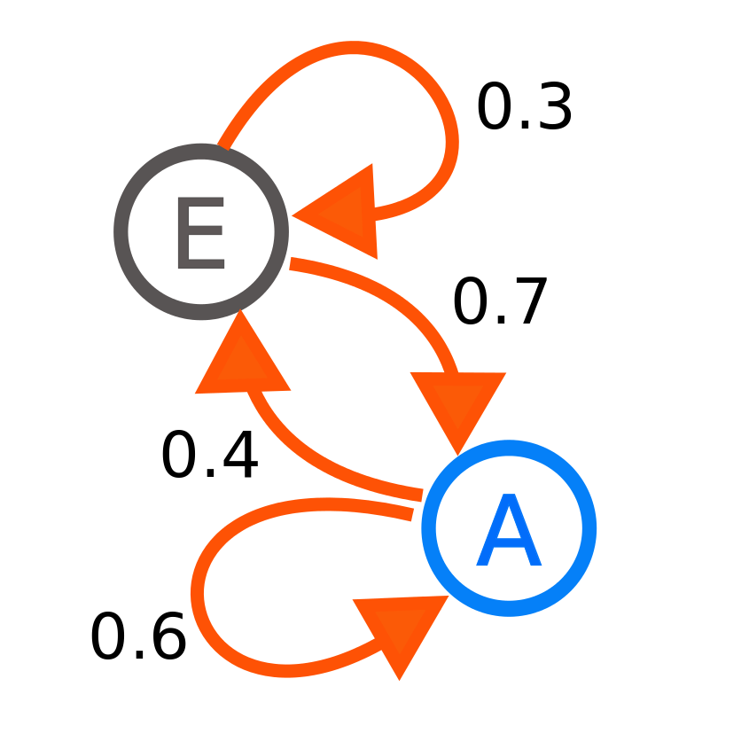

Slide 6
I went alone
I went to the zoo
I went to the mall
I was sick
I was joggin

Slide 7
alone
zoo
went
to
the
I
sick
mall
was
I went alone
I went to the zoo
I went to the mall
I was sick
I was joggin
joggin

Slide 8
{I, went} {went, alone}
{I, went} {went, to} {to, the} {the, zoo}
{I, went} {went, to} {to, the} {the, mall}
{I, was} {was, sick}
{I, was} {was, joggin}
Words
{I}
{w, went} {we, went} {wen, went}
{a, alone} {al, alone} {alo, alone} {alon, alone}
{t, to}
{t, the} {th, the}
{z, zoo} {zo, zoo}
{m, mall} {ma, mall} {mal, mall}
{w, was} {wa, was}
{s, sick} {si, sick} {sic, sick}
{j, joggin} {jo, joggin} {jog, joggin}, {jogg, joggin} {joggi, joggin}
Context
Train data
I went alone
I went to the zoo
I went to the mall
I was sick
I was joggin

Slide 9
+
Words
Context

Slide 10
under context ?
no
user input
query words MC
yes
select candidates starting with user input
query context MC
user selection
sort candidates by occurence
user selection
re weight MCs

